Slide 1

E-MEDICARE APPLICATION
This Photo by Unknown Author is licensed under CC BY

Slide 2
GROUP 1 : PROJECT MEMBERS
2529352 Pradeepa S
2528422 Dhivyabharathi D
2528874 Sherlin X
2529073 Anuchitra C
2529179 Abhiram K V
2529059 M Prasanth
2529069 R Deepak Kumar
2527997 Dhaneshan S
2529099 Sonu Patidar
2530684 Harini Kandasami

Slide 3
TABLE OF CONTENTS
Abstract
Introduction
Proposed system
Technology used
Environment
Modules
Flow diagram
Output
Advantages
Conclusion
Future Scope
References

Slide 4
ABSTRACT
Online shopping has now become an inevitable practice in today's hectic environment, and doing so for something as important as pharmaceuticals is also equally essential.
In order to supply your medications safely, promptly, and wherever you are, we have E-medicare here.

Slide 5
INTRODUCTION
E-Medicare is an online web portal, which enables the customers to order medicines , anywhere and anytime.
This application can handle Medical information, facilitates booking from various distributors all over the world and provides 24✖7 customer support.
This practice will automate the procedure of medicine supply through the Pharmaceuticals Company and improve business standards and customer relationships.
This also allows the people in rural areas and inaccessible areas to utilize the power of telemedicine to it’s fullest.

Slide 6
PROPOSED SYSTEM
The proposed Online Medical Store system will completely revolutionize the industry.
Separate logins for admin and user.
Admin can add , update and delete the medicine details at a single click.
Most viewed products can also be seen for the reliability of E-medicare among people.
Searching of products, placing orders, billing and product stock can easily be maintained at a single click.
Customer can send their feedback or suggestions if any.

Slide 7
TECHNOLOGY USED
Front End
HTML : To structure web pages and its content.
CSS : To style and layout web pages.
Bootstrap : To make the websites more responsive.
Angular CLI : To initialize, develop, scaffold, and maintain Angular applications directly from a command shell.
Back End
Java : To handle business logic.
MySQL : To handle databases.

Slide 8
ENVIRONMENTAL SETUP
This application will be developed using Windows OS using J2EE and JSON Server.
Hardware-11th Gen Intel(R) Core(TM) i5 3.11 GHz 16.0 GBRAM 1TB Storage
Visual Studio Code.
Eclipse IDE or Spring tool Suite.
Server- Apache tomcat and JSON server.
Database - MySQL, Hibernate ORM.
Node version 16.
Angular CLI.
Spring boot framework.

Slide 9
MODULES OF E MEDICARE APPLICATION
Admin Module: Used for managing medicine details and user information.
Users Module: Used for managing the users of the system.
Medicine Module: Used for managing the Medicine details.
Cart Module: Used for managing the details of Order.
Contact us Module: To let user contact and provide.

Slide 10
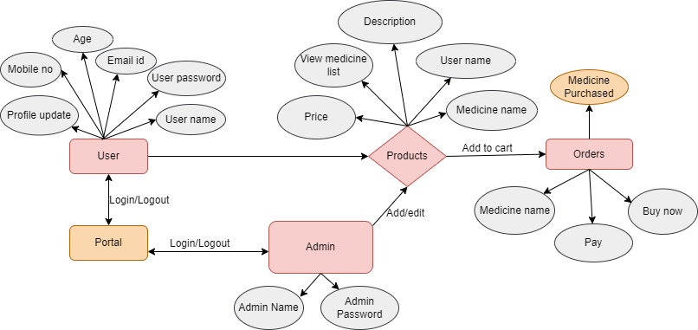
FLOW DIAGRAM

Slide 11
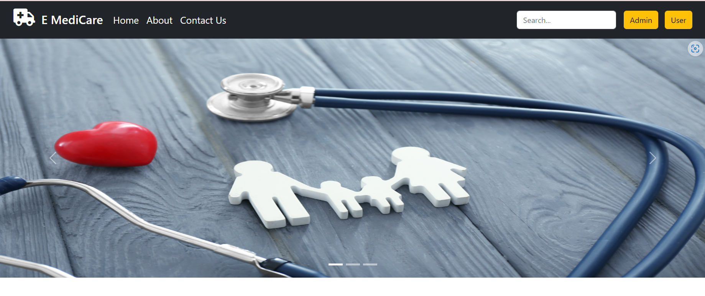
OUTPUT SCREENSHOTS

Slide 12
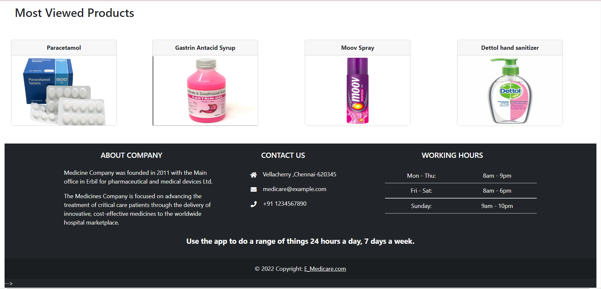

Slide 13
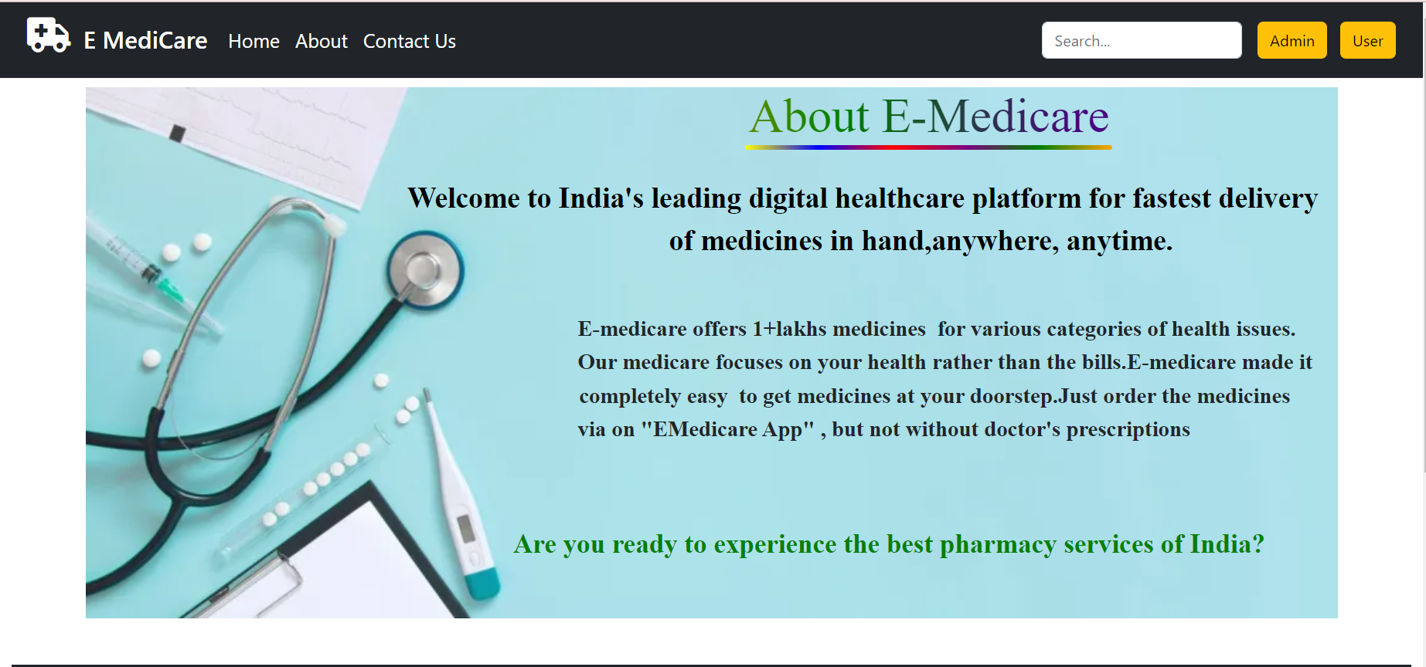

Slide 14
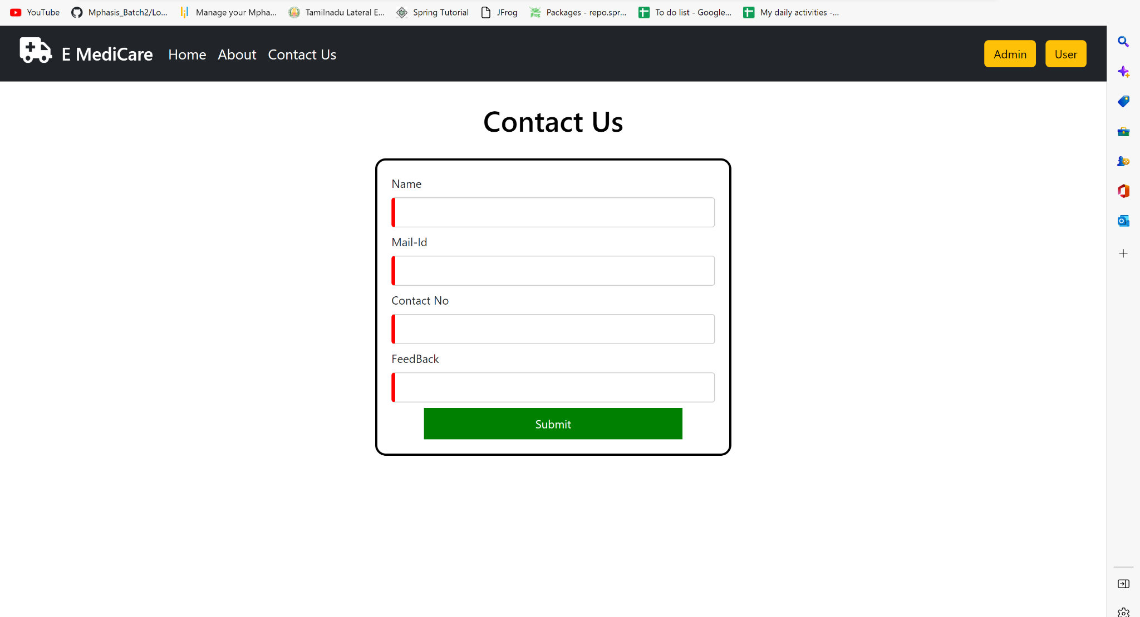

Slide 15
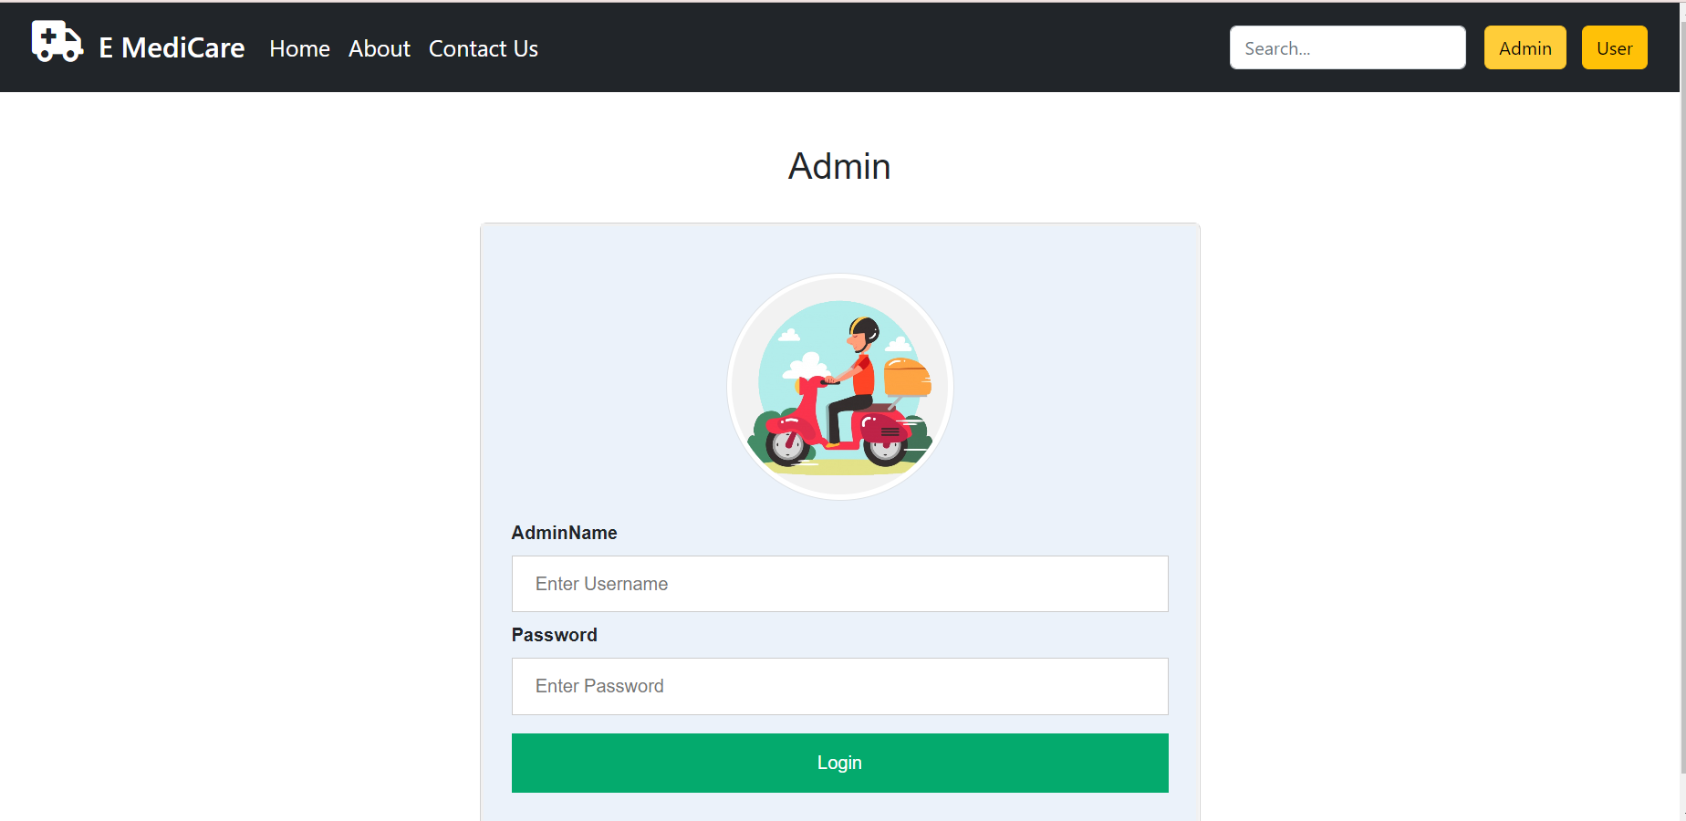

Slide 16
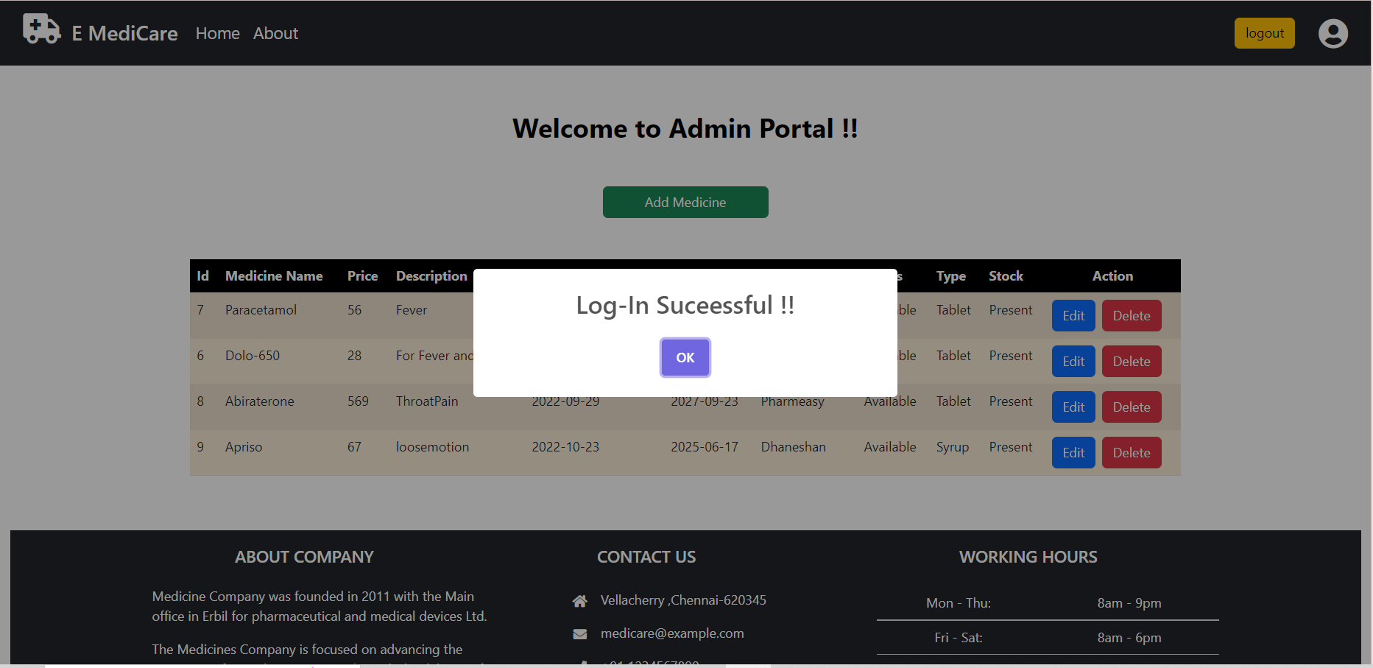

Slide 17
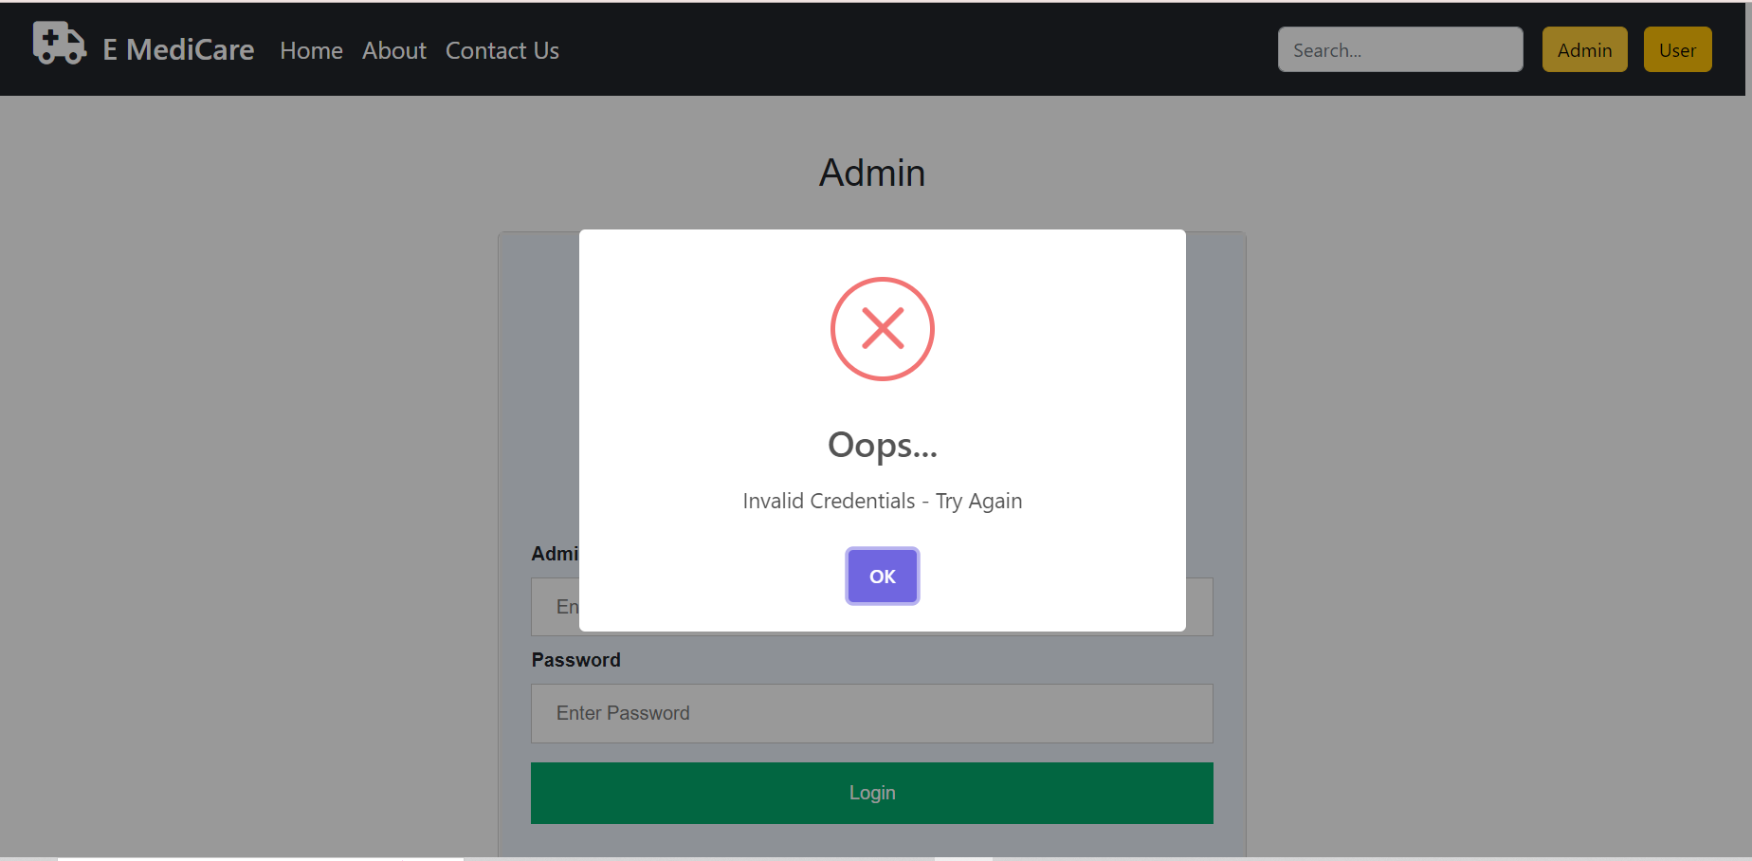

Slide 18
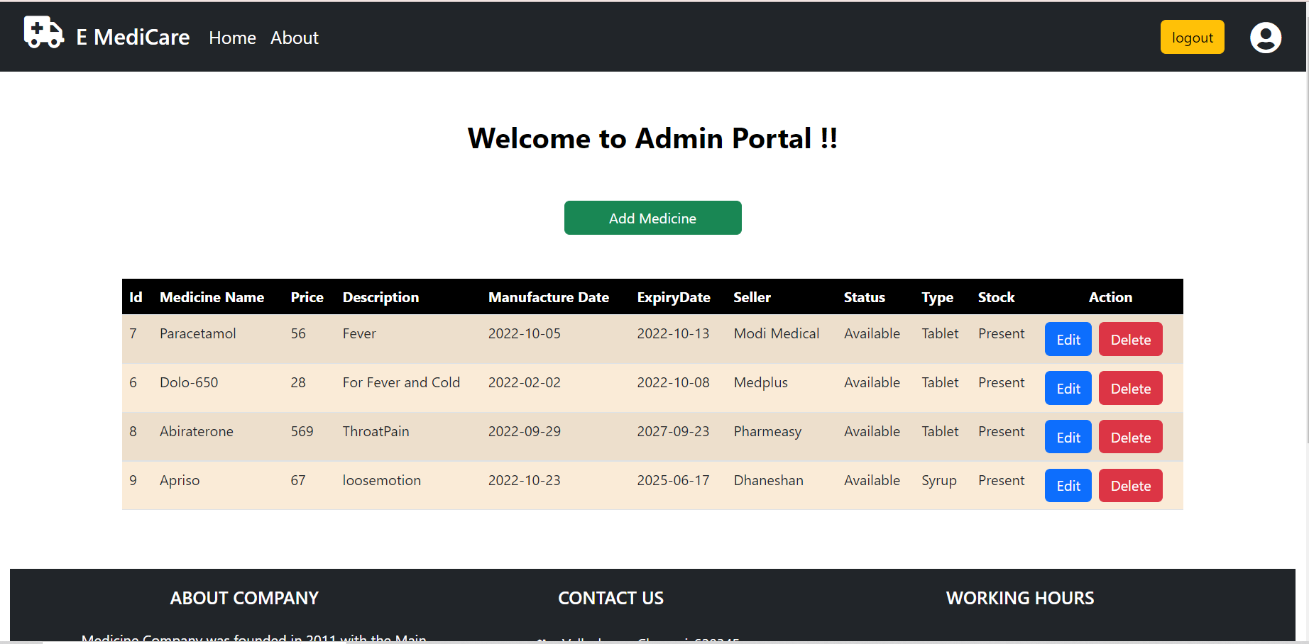

Slide 19
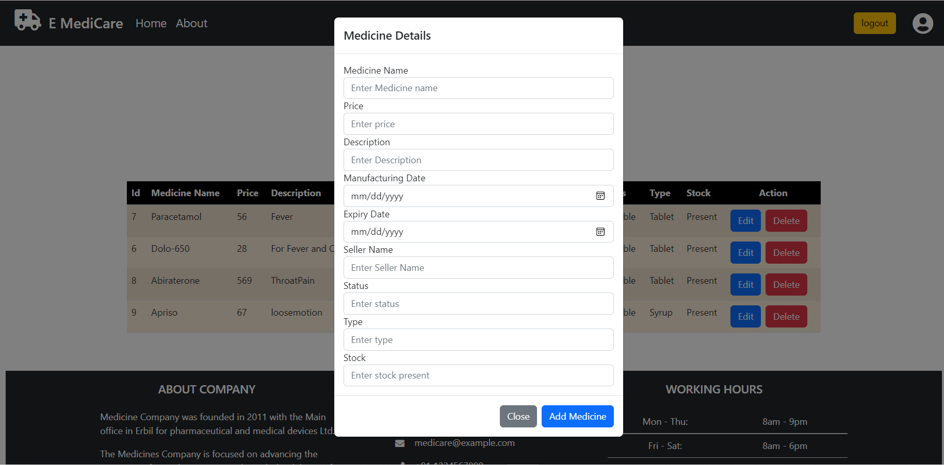

Slide 20
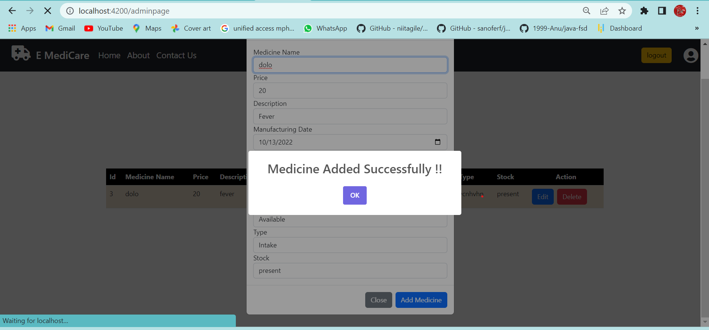

Slide 21
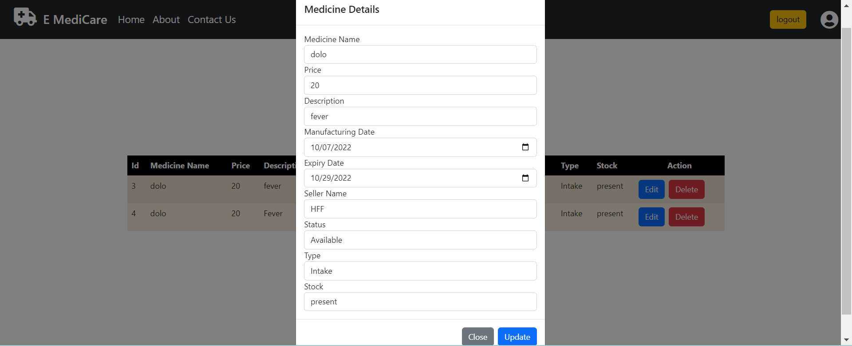

Slide 22
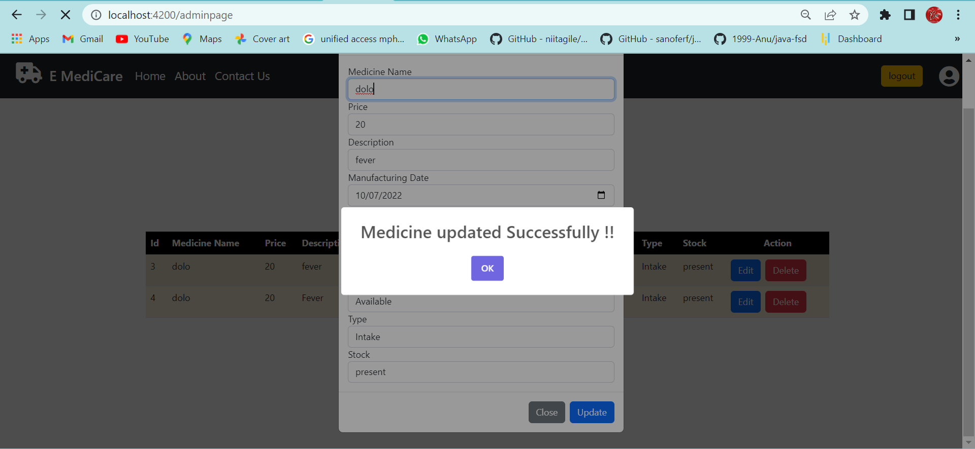

Slide 23
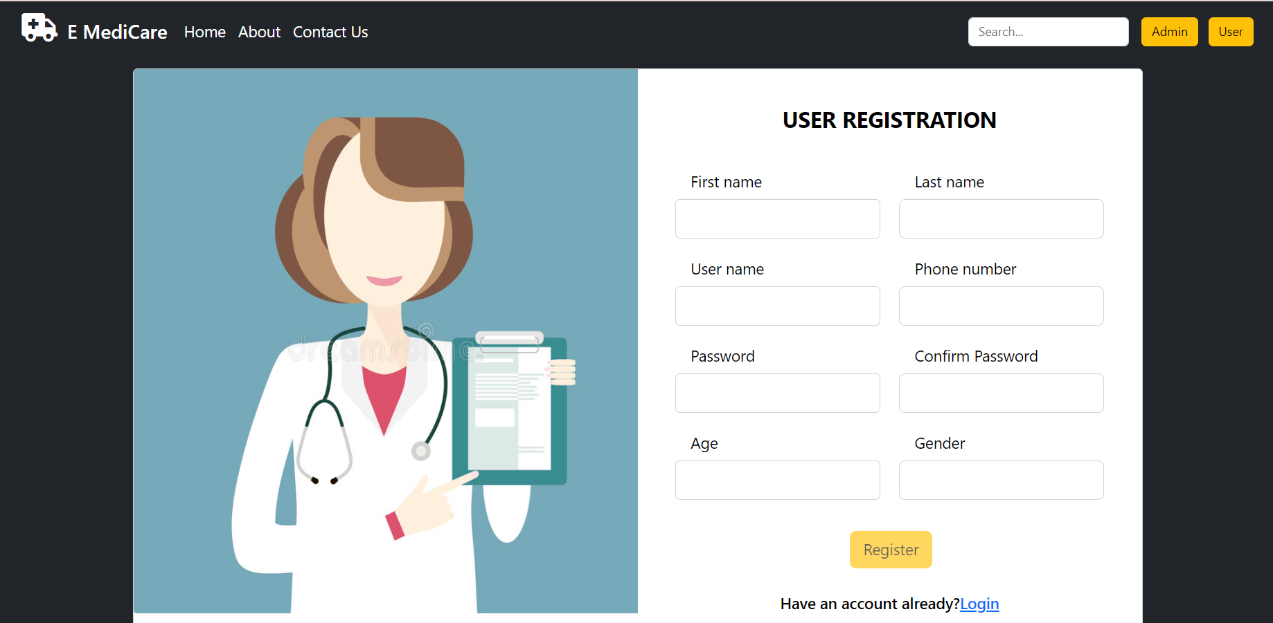

Slide 24
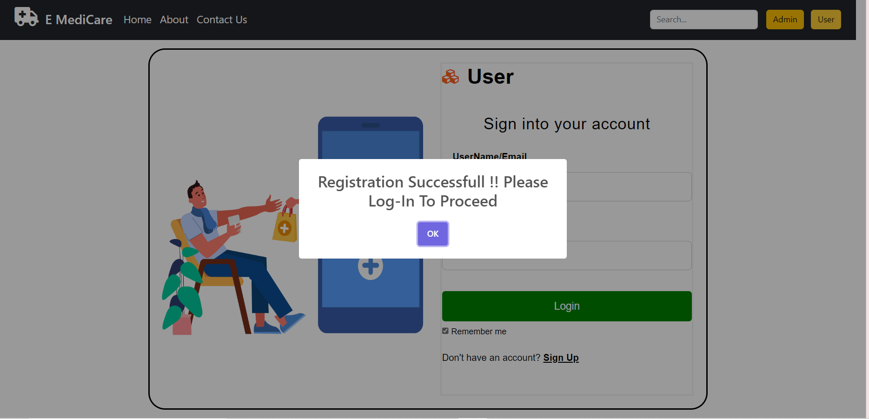

Slide 25
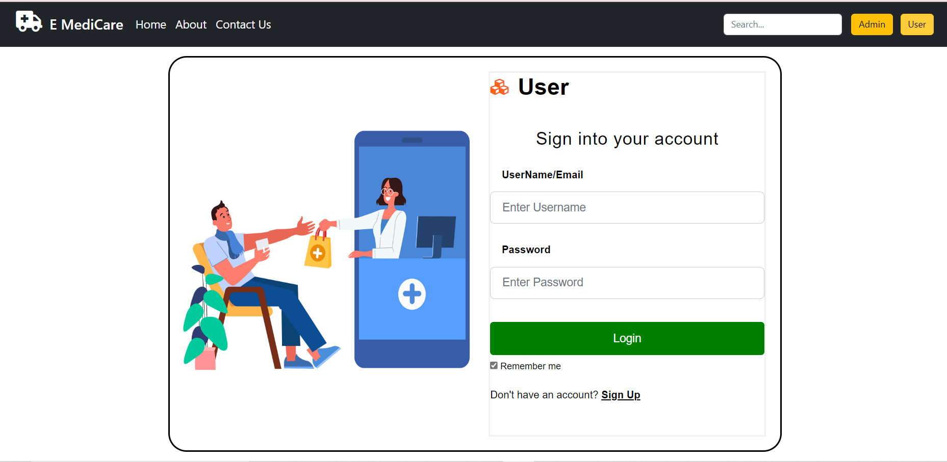

Slide 26
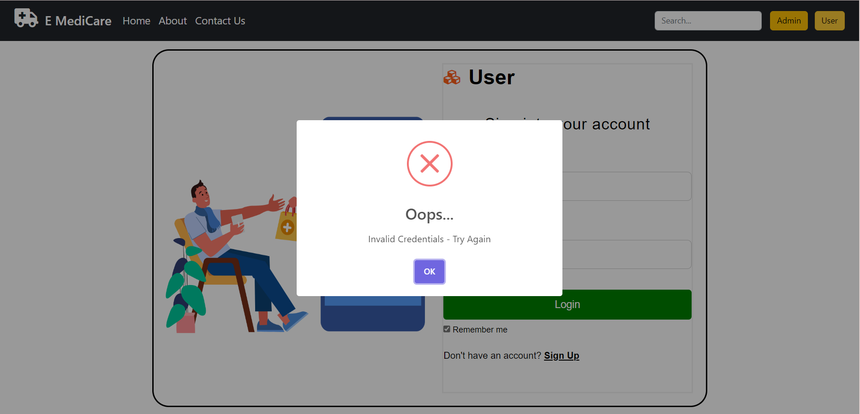

Slide 27
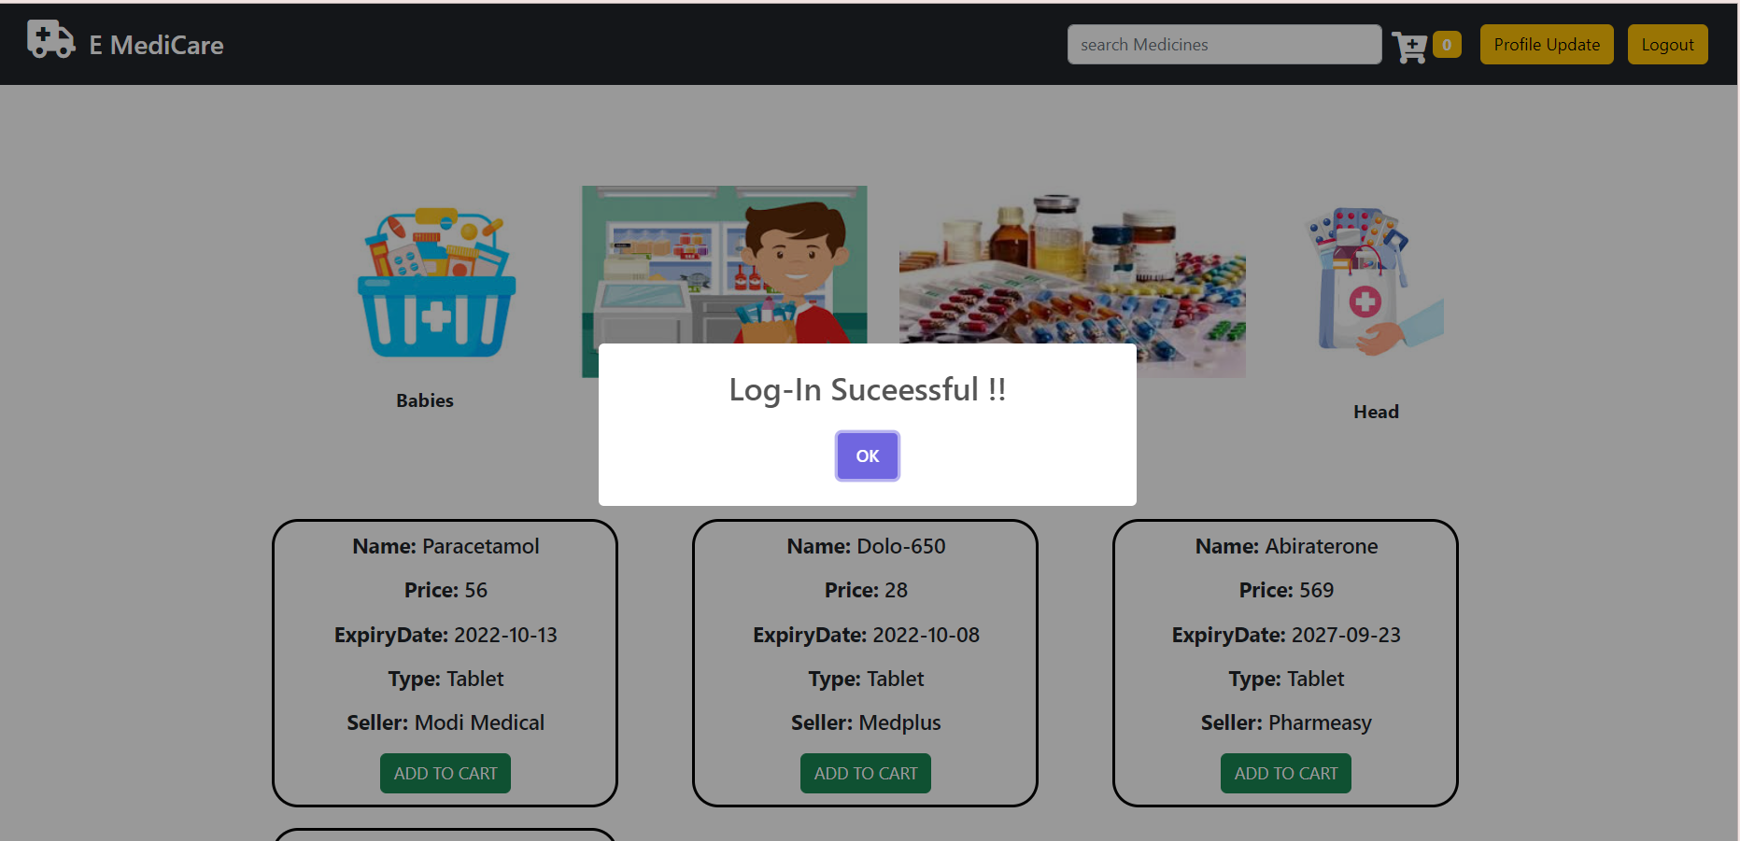

Slide 28
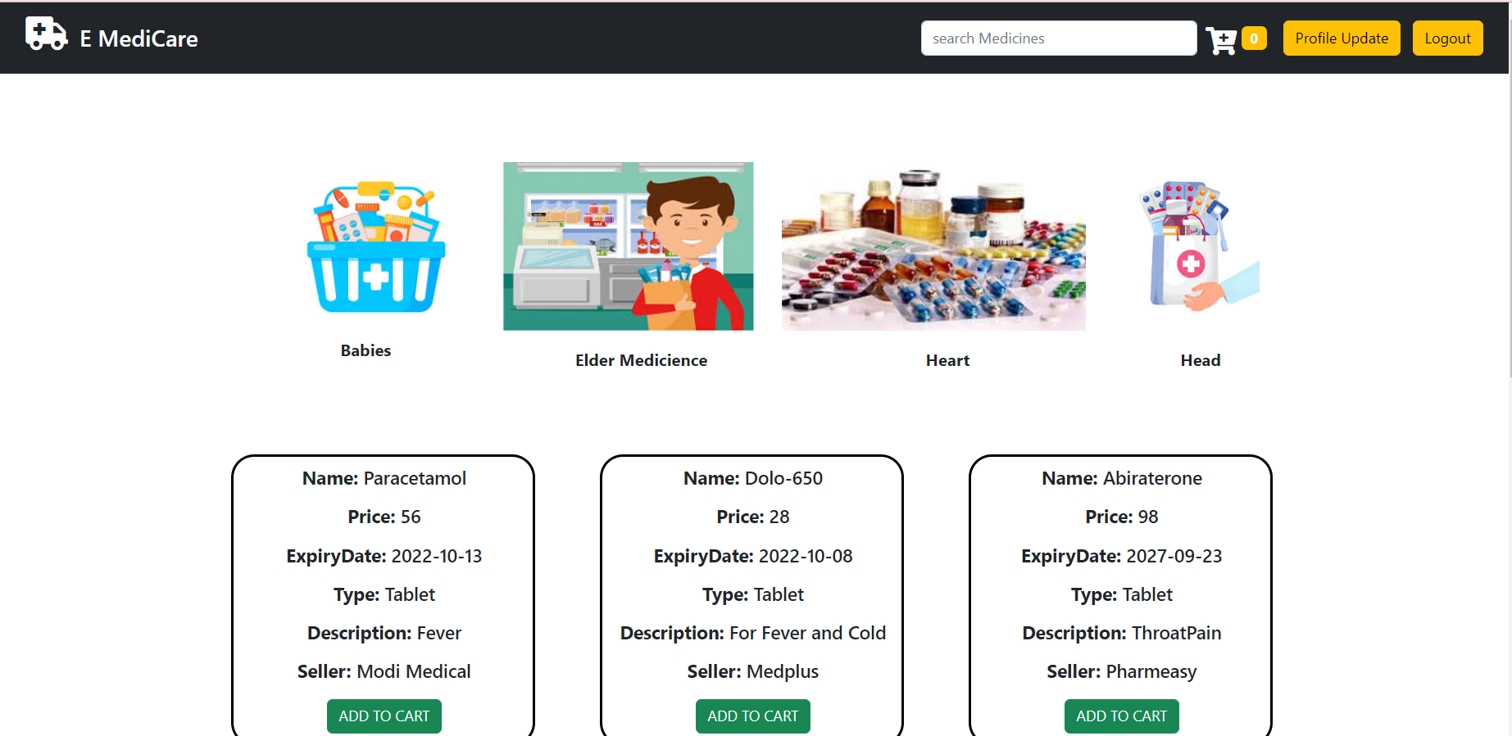

Slide 29
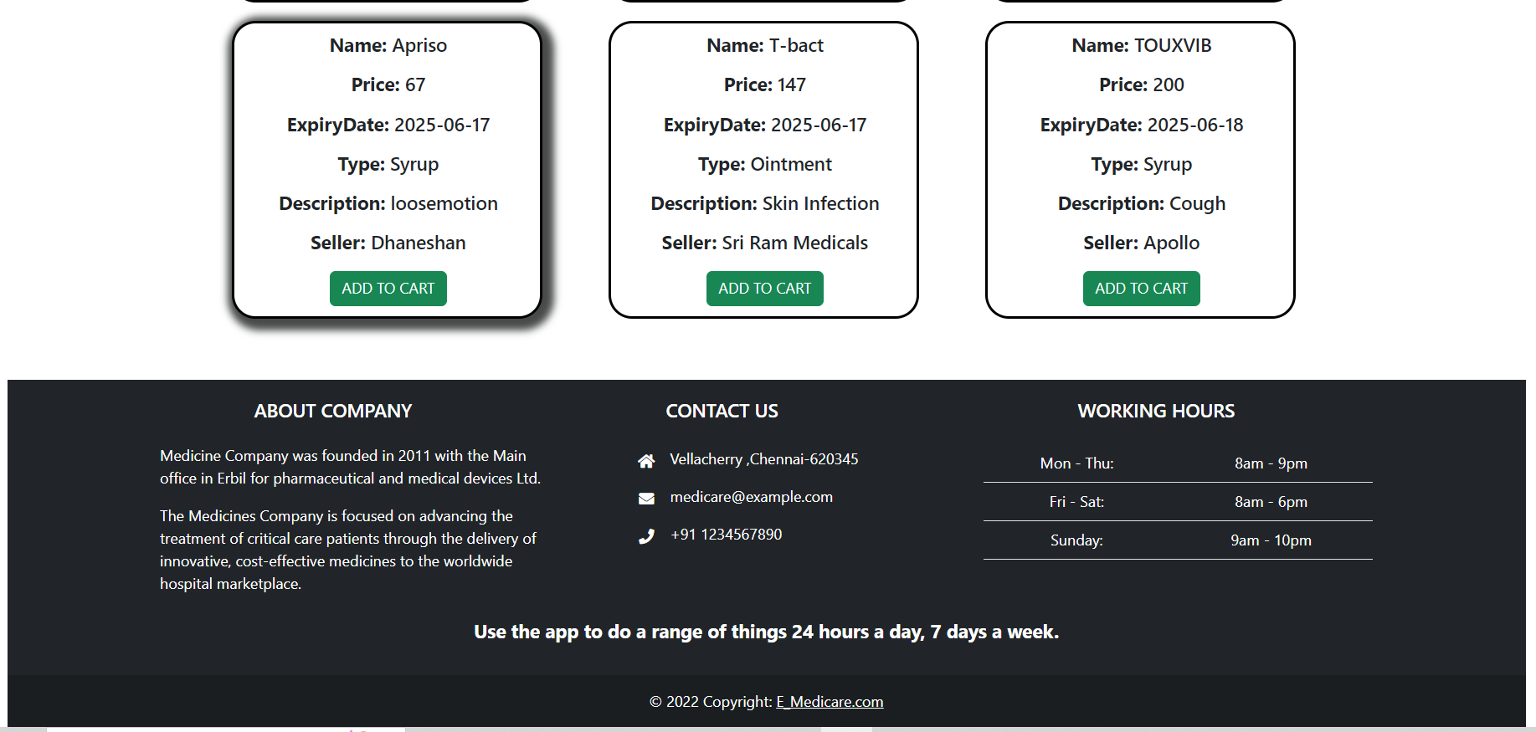

Slide 30
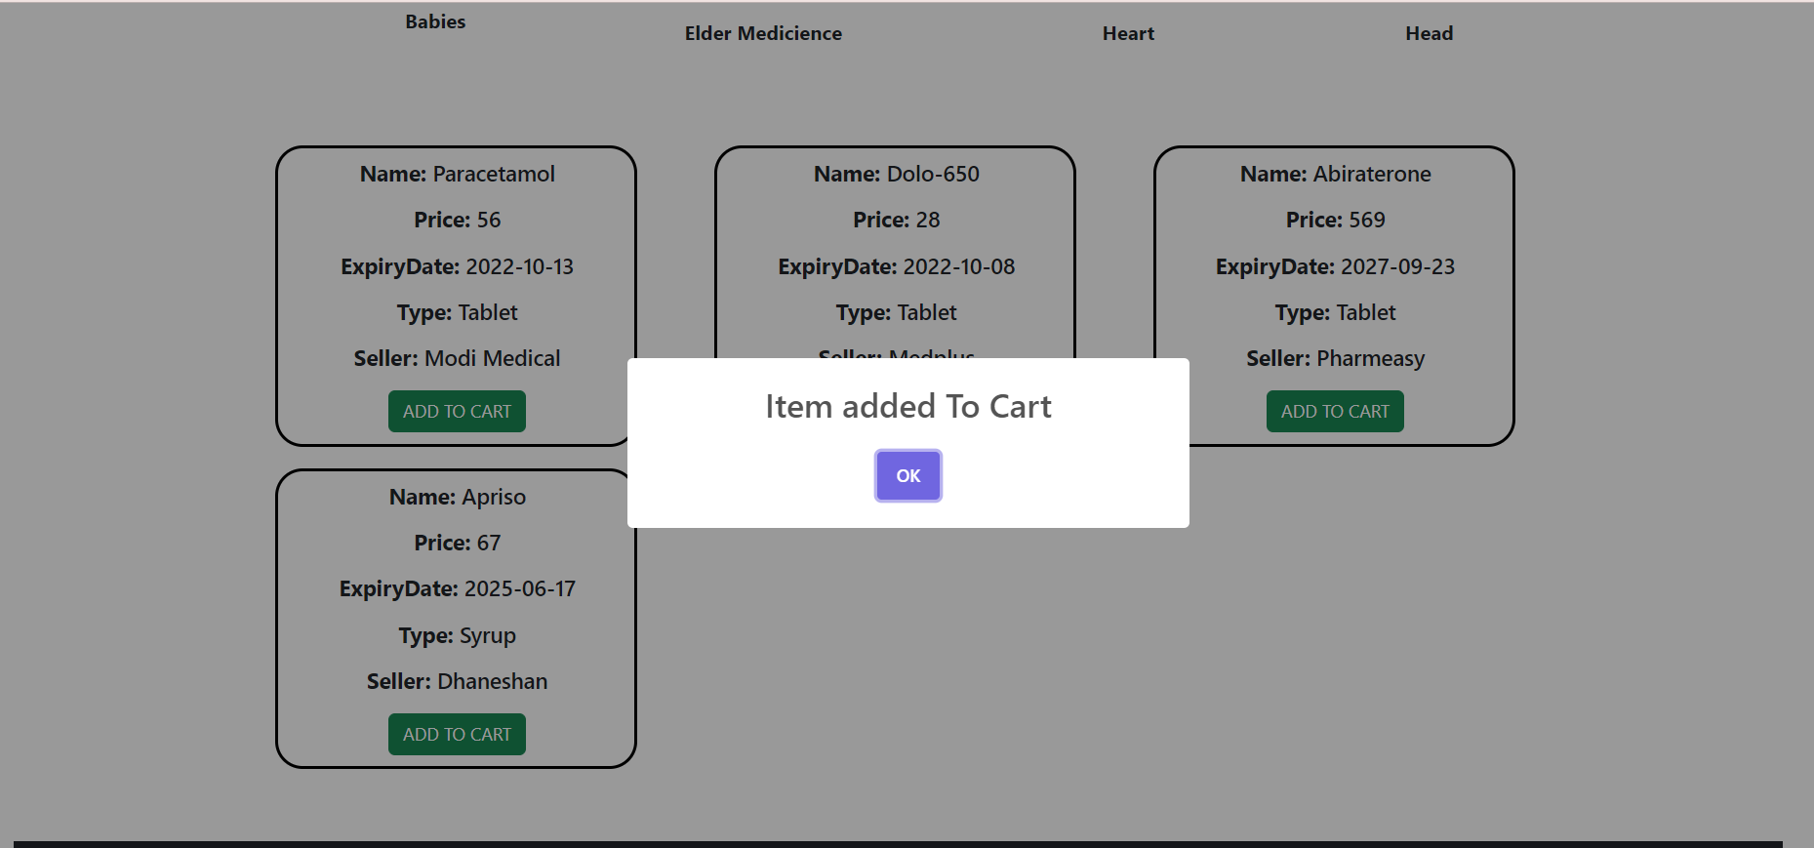

Slide 31
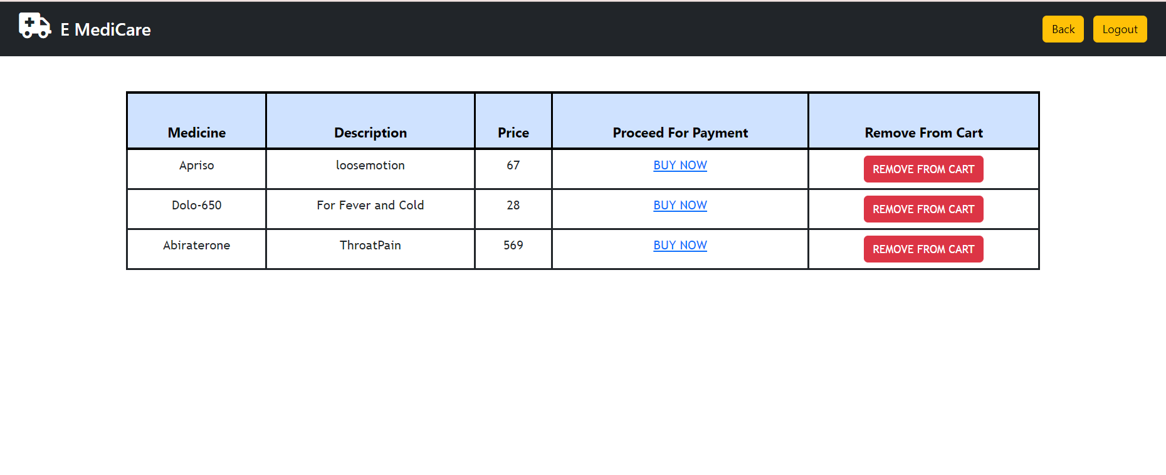

Slide 32
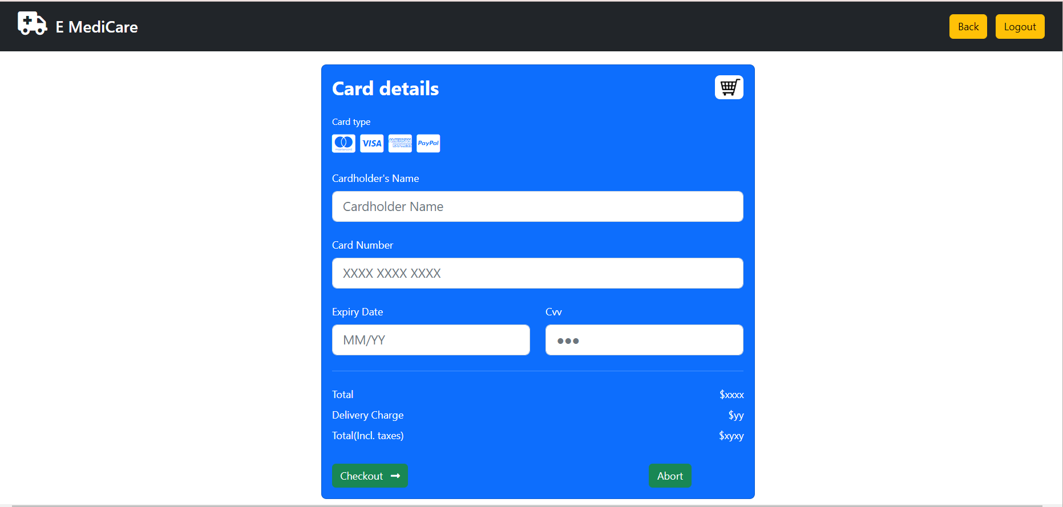

Slide 33
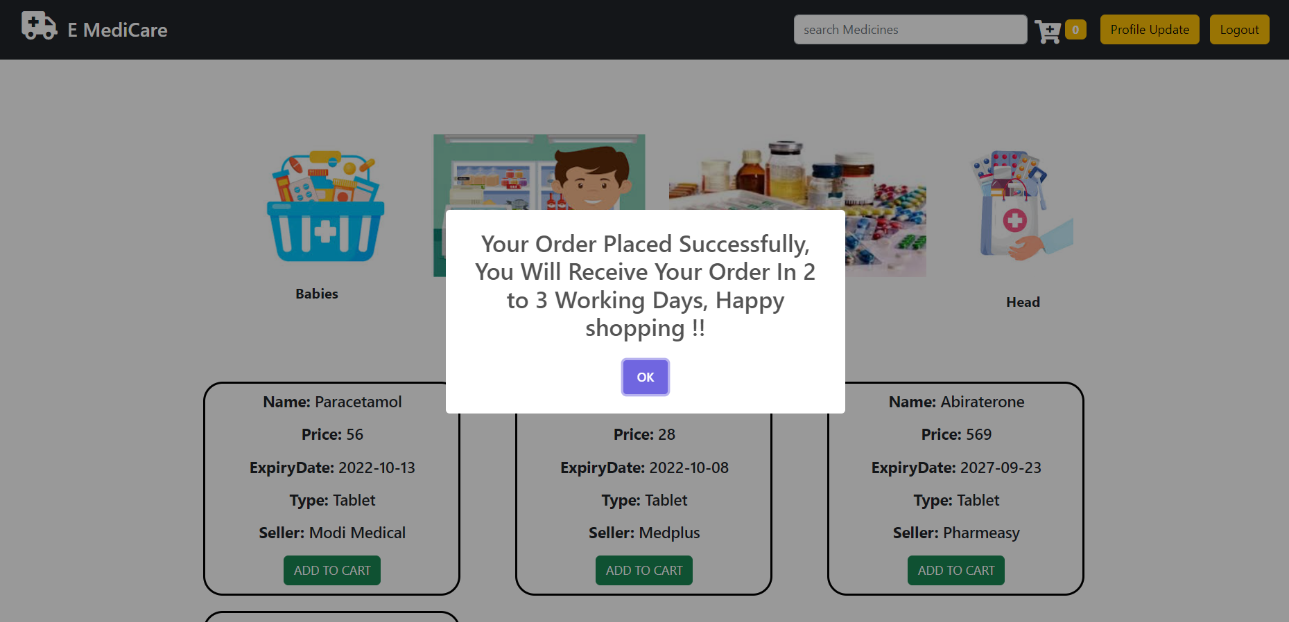

Slide 34
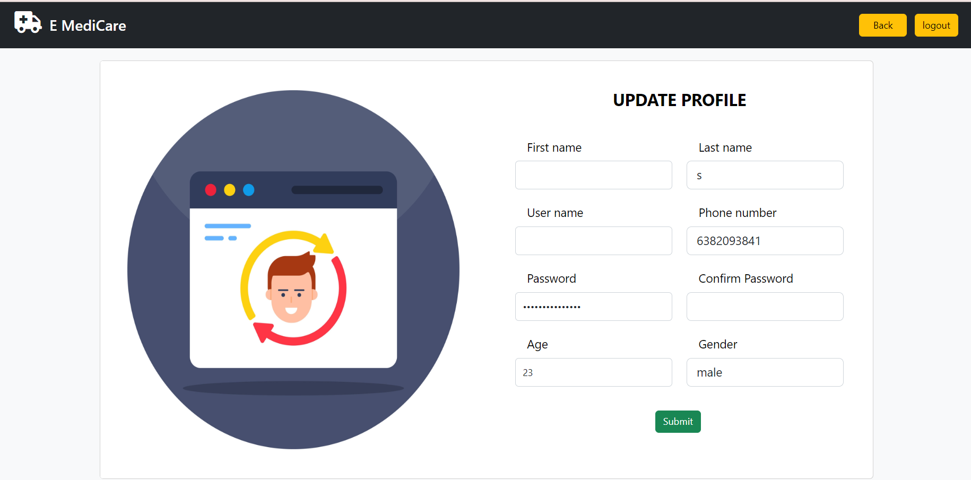

Slide 35
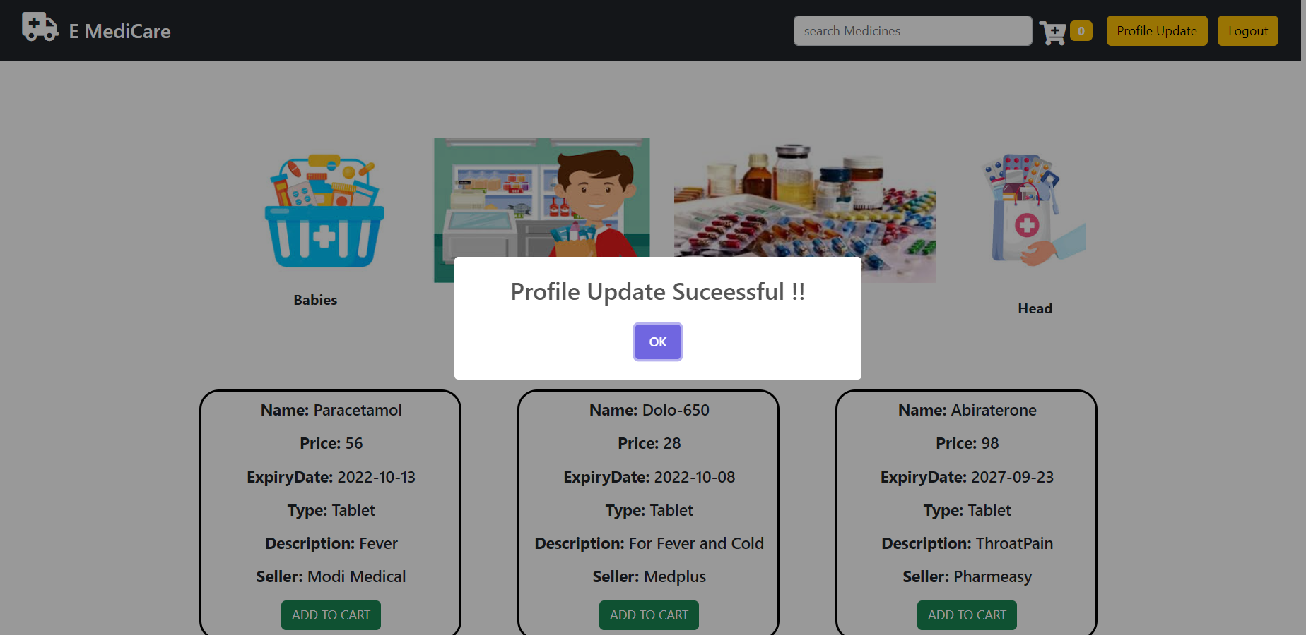

Slide 36
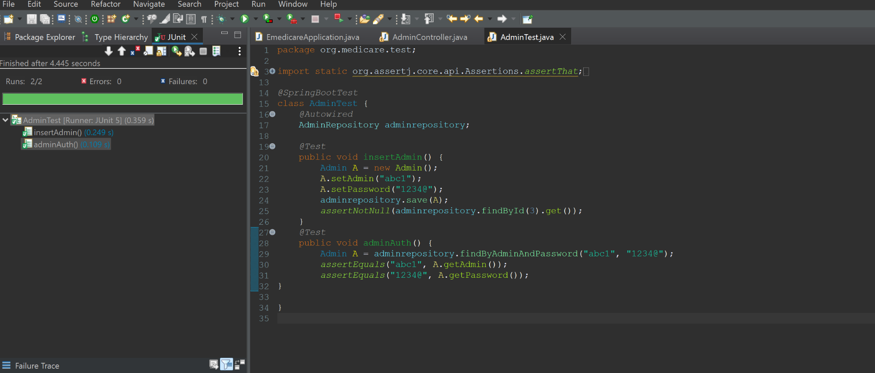

Slide 37
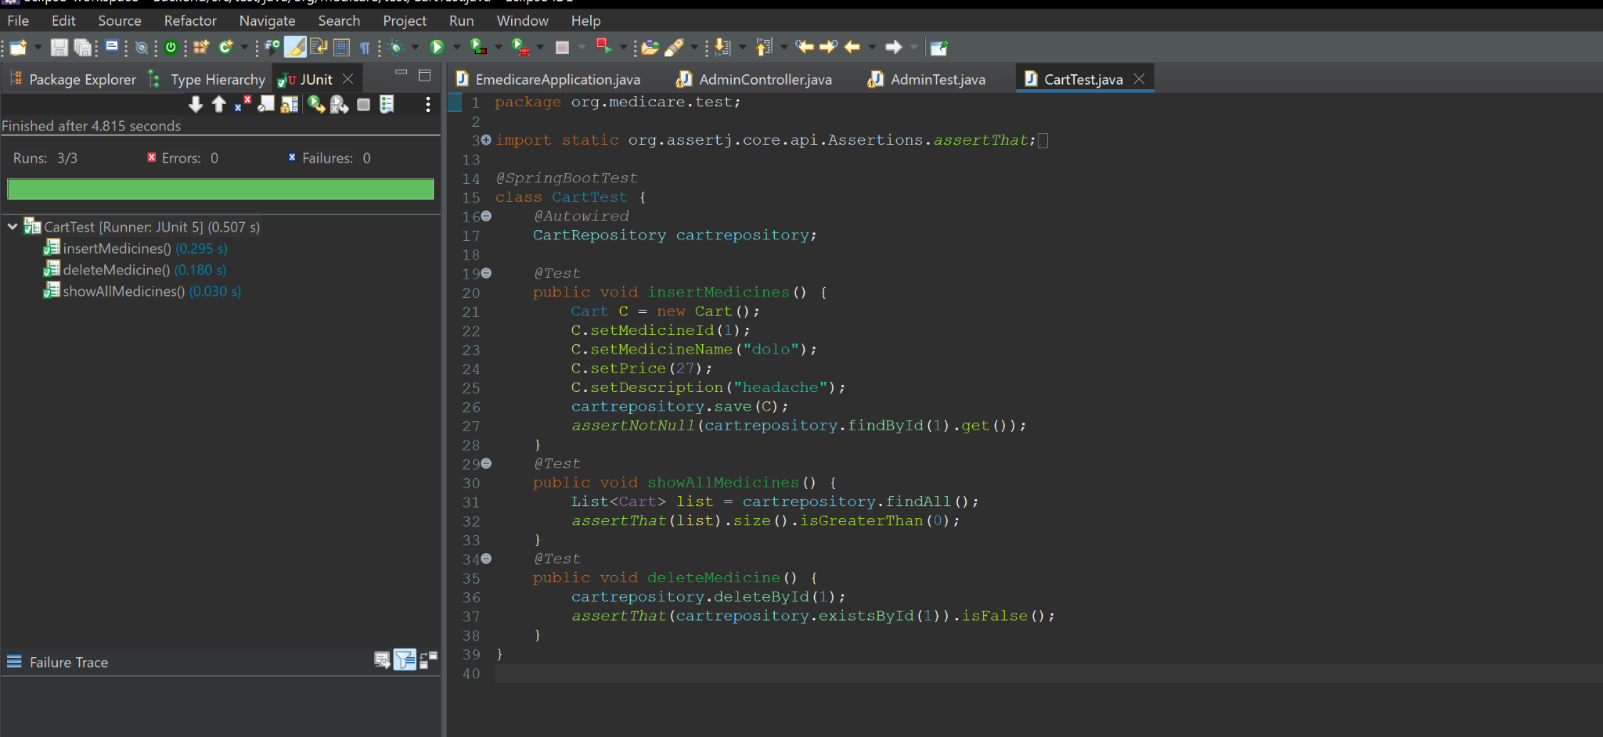

Slide 38
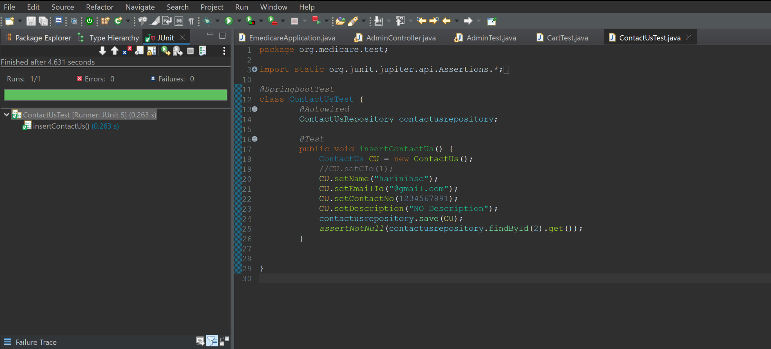

Slide 39
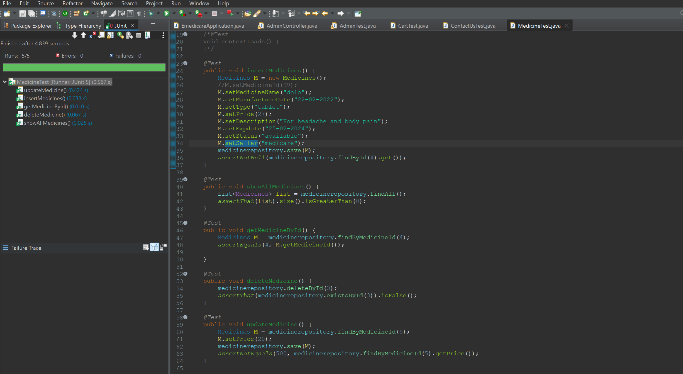

Slide 40
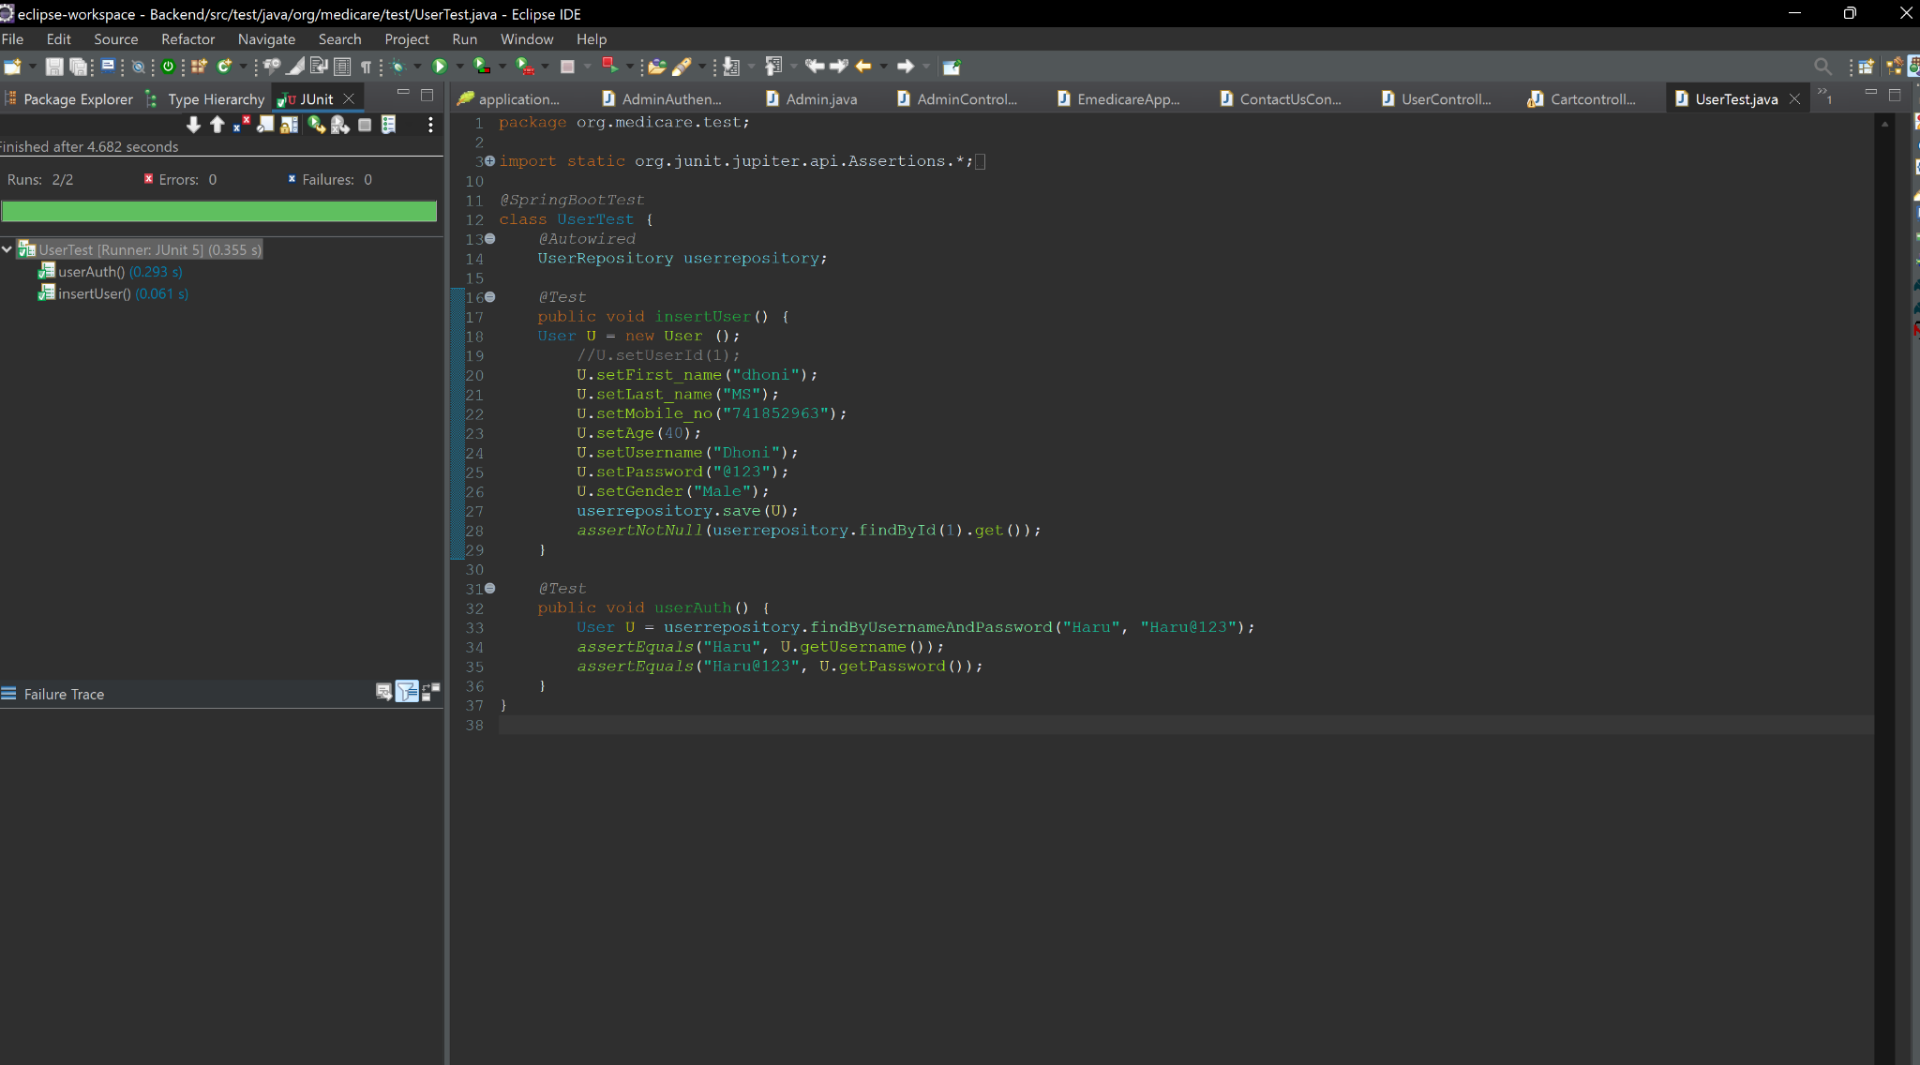

Slide 41
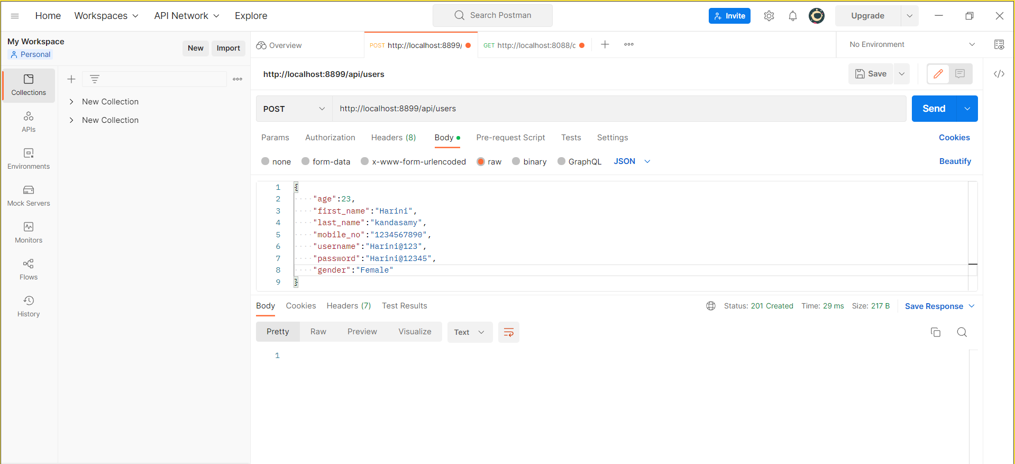

Slide 42
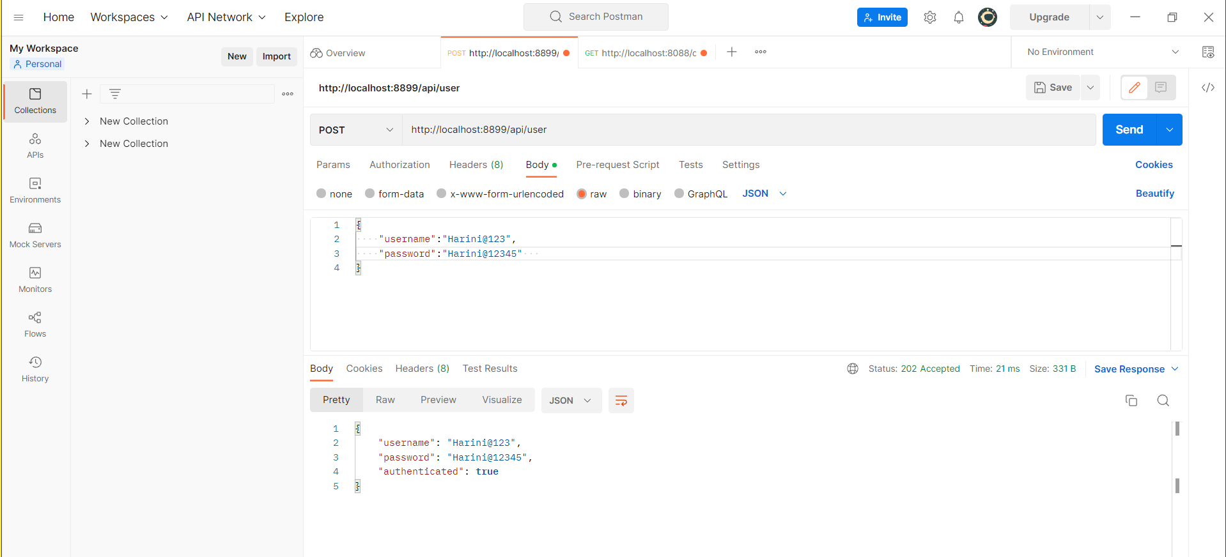

Slide 43
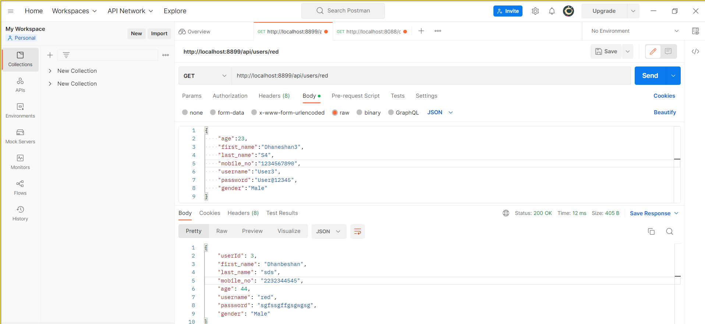

Slide 44
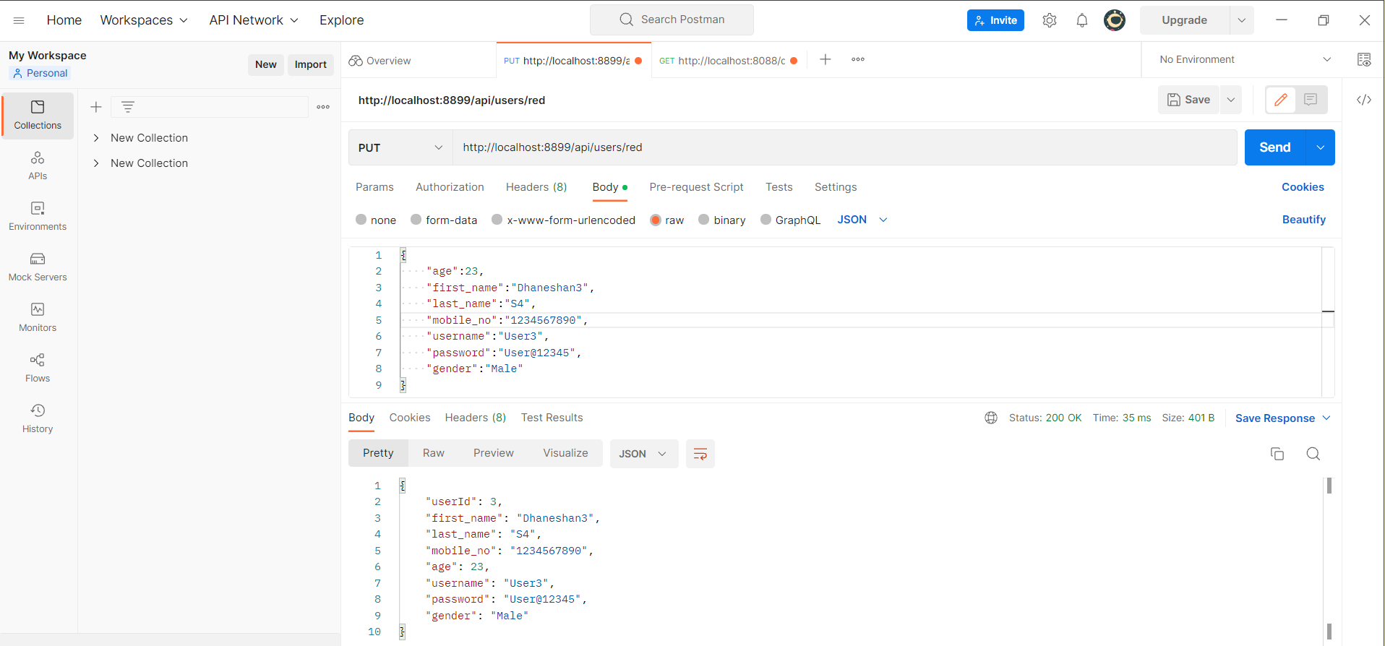

Slide 45
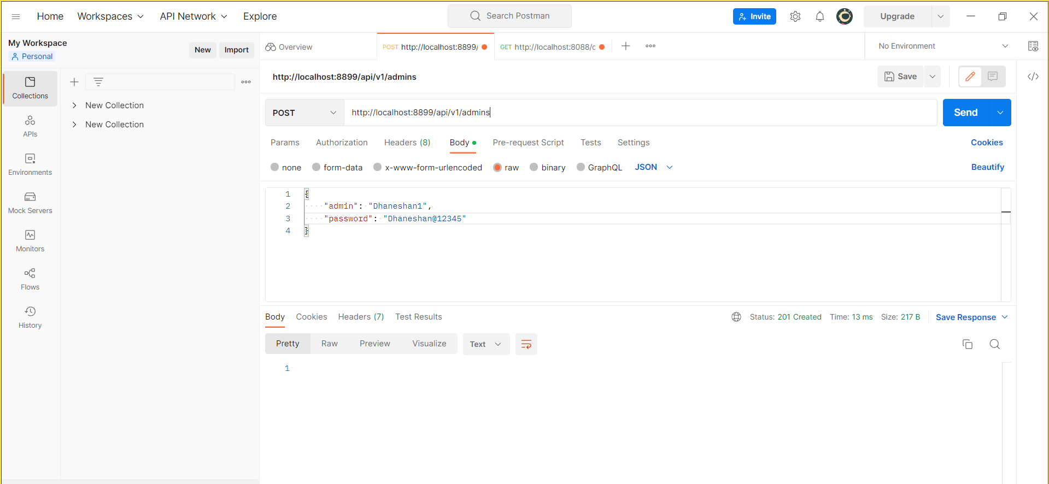

Slide 46
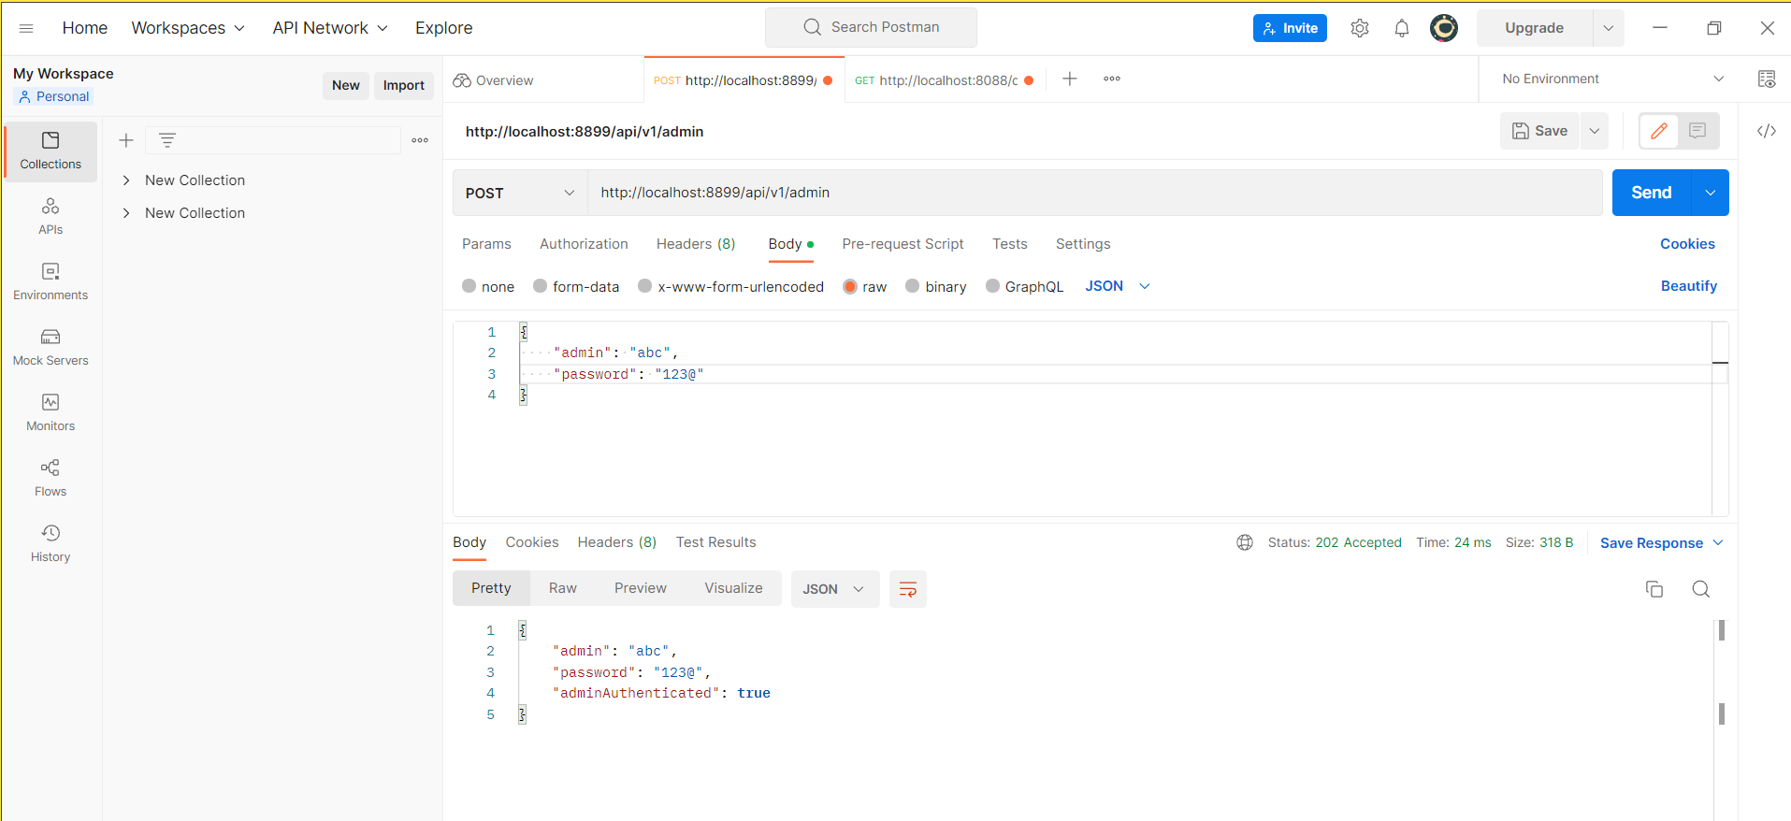

Slide 47
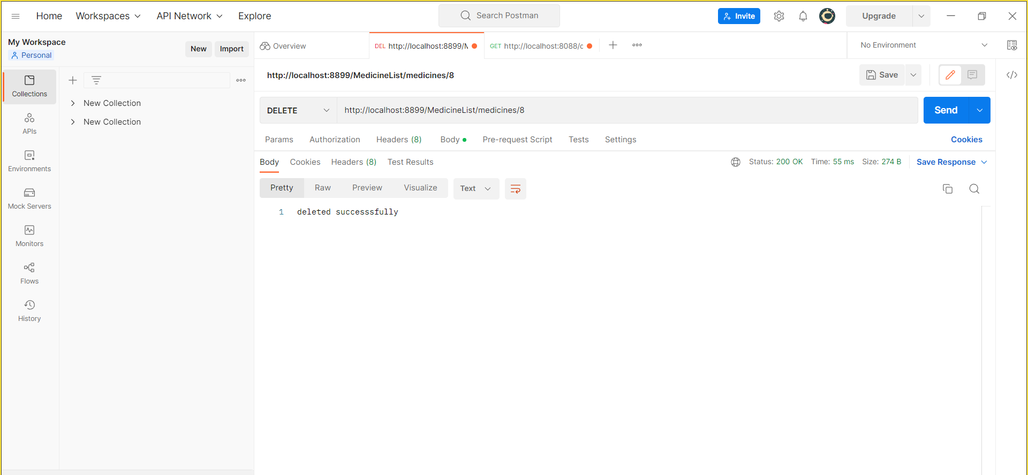

Slide 48
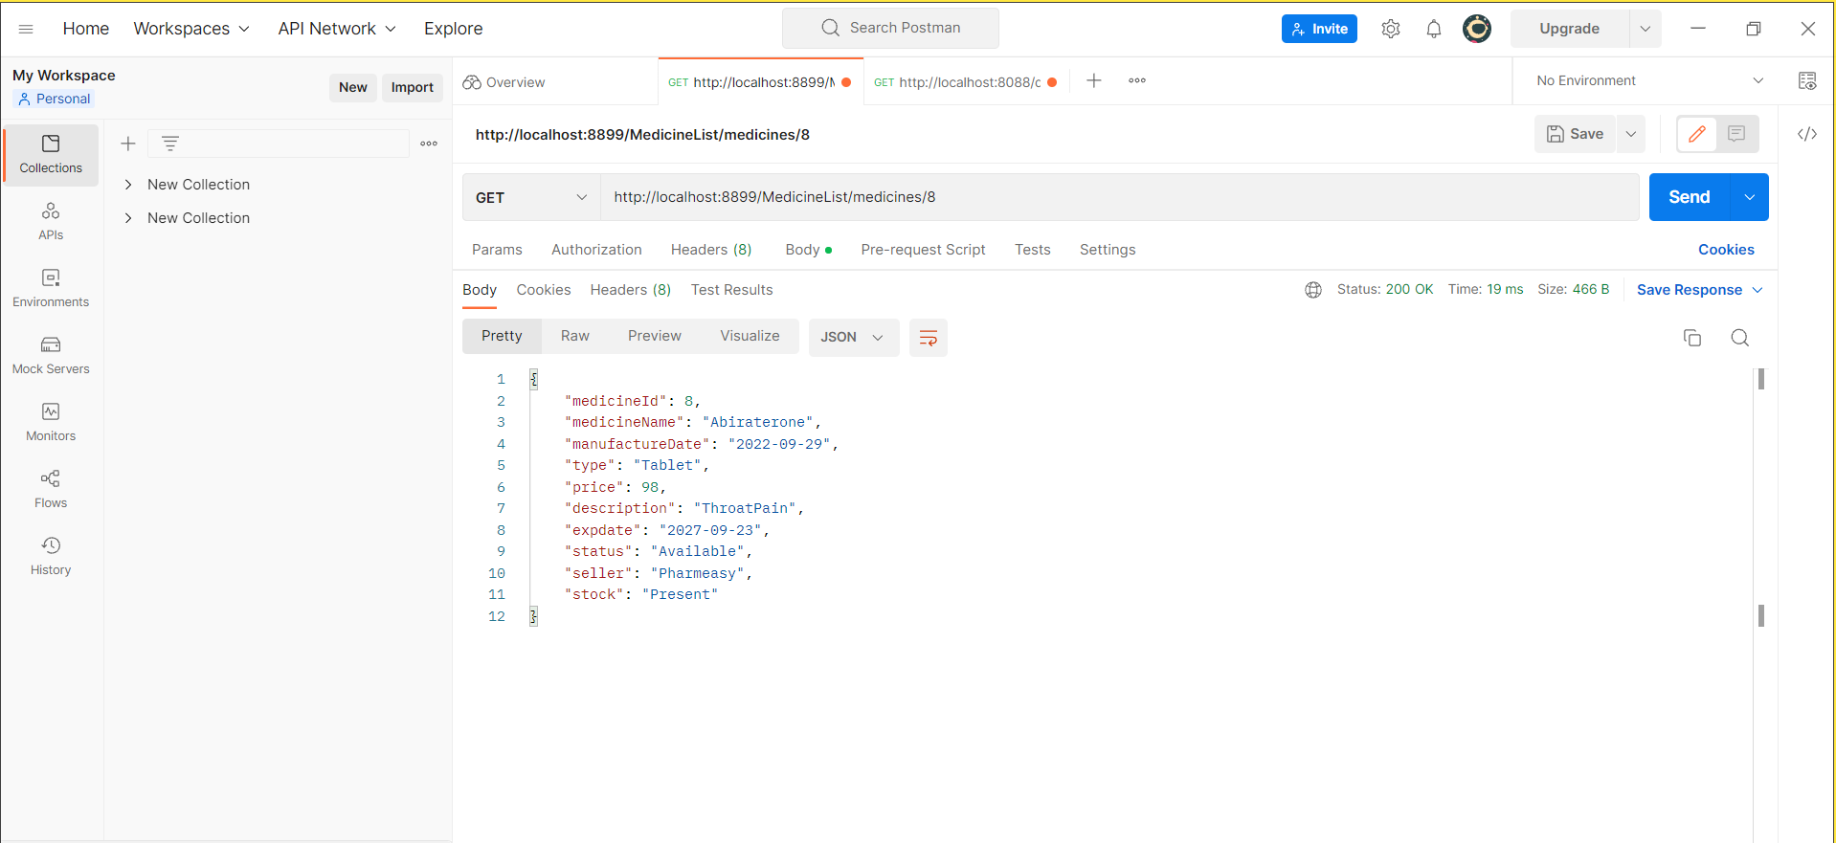

Slide 49
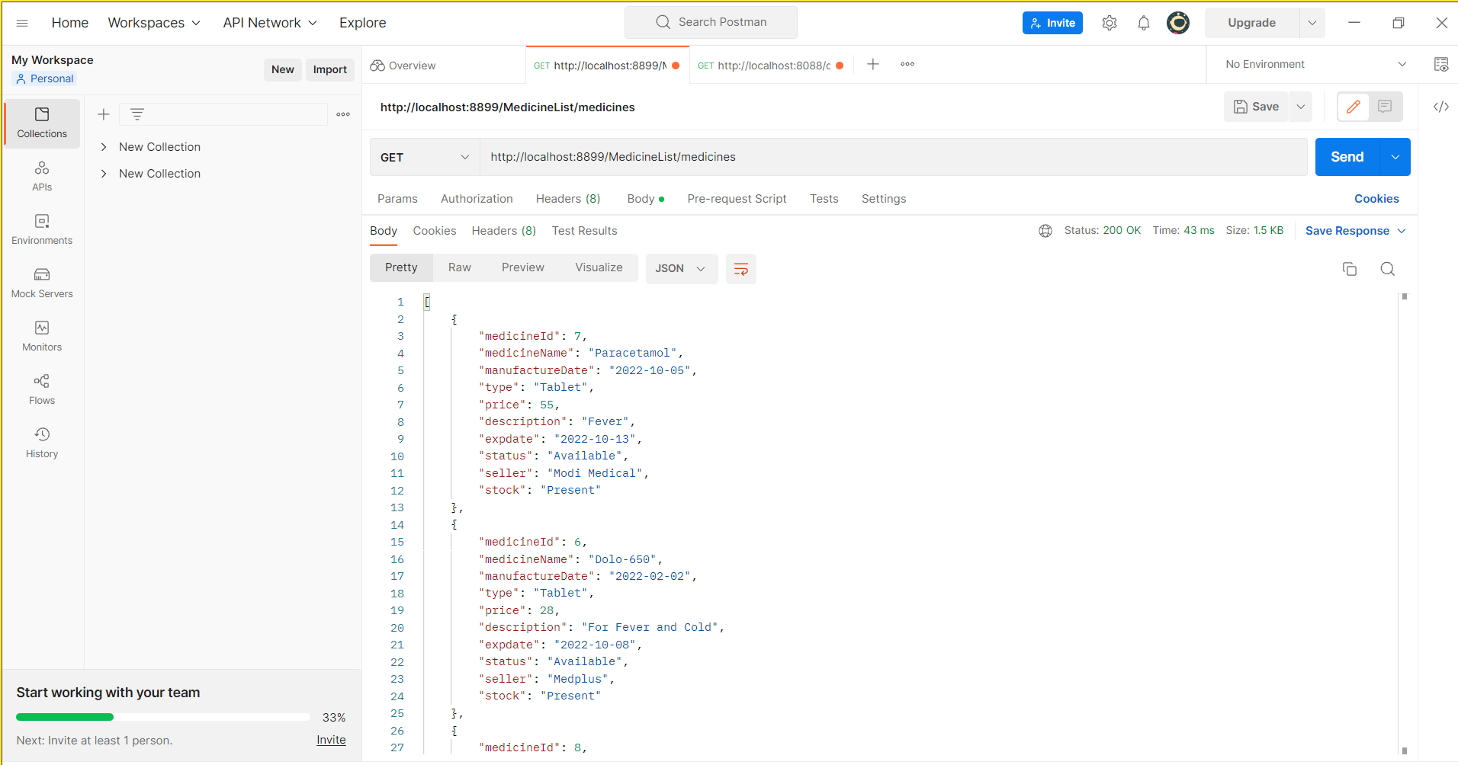

Slide 50
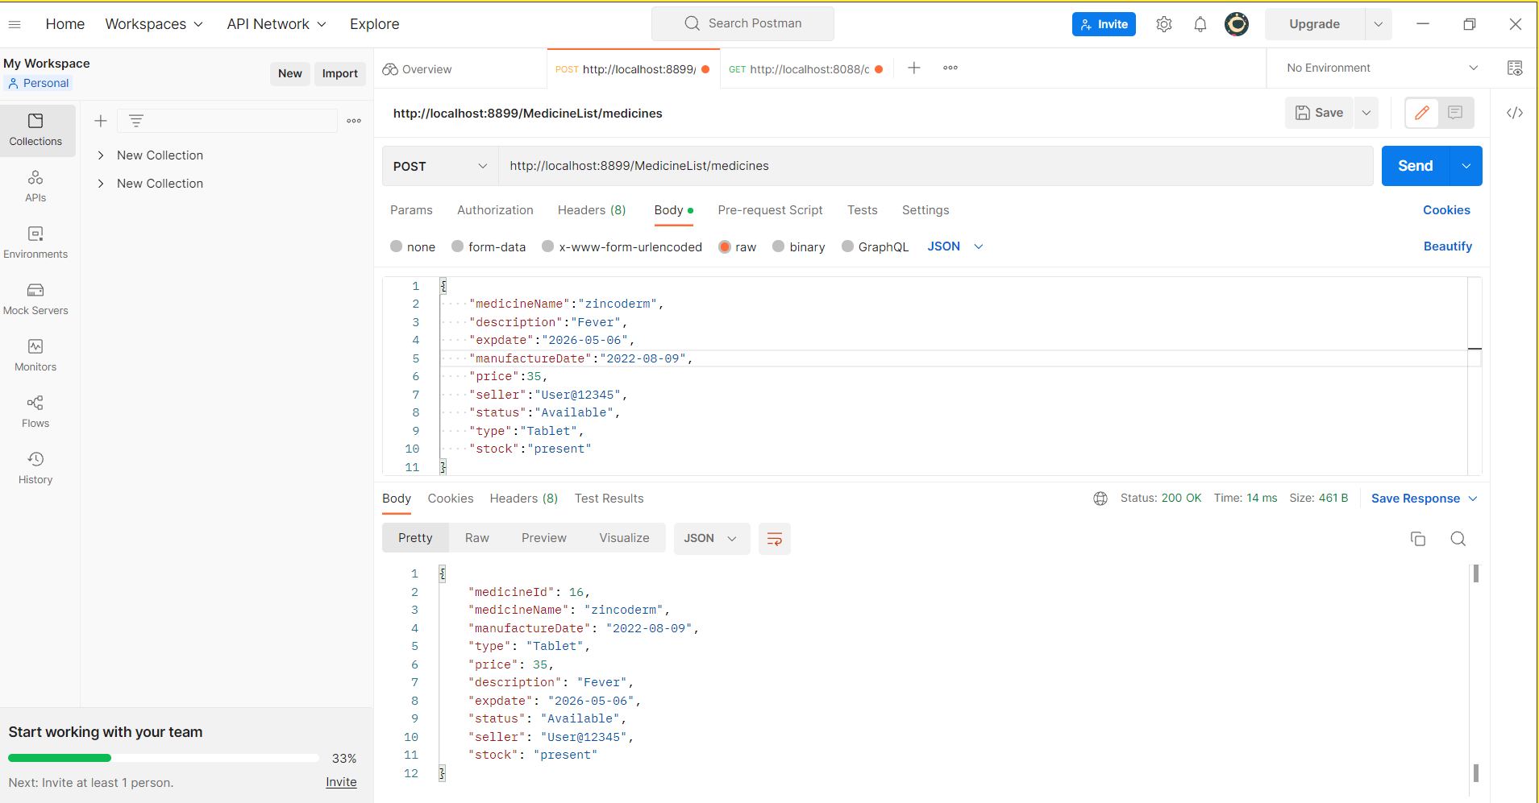

Slide 51


Slide 52


Slide 53


Slide 54


Slide 55
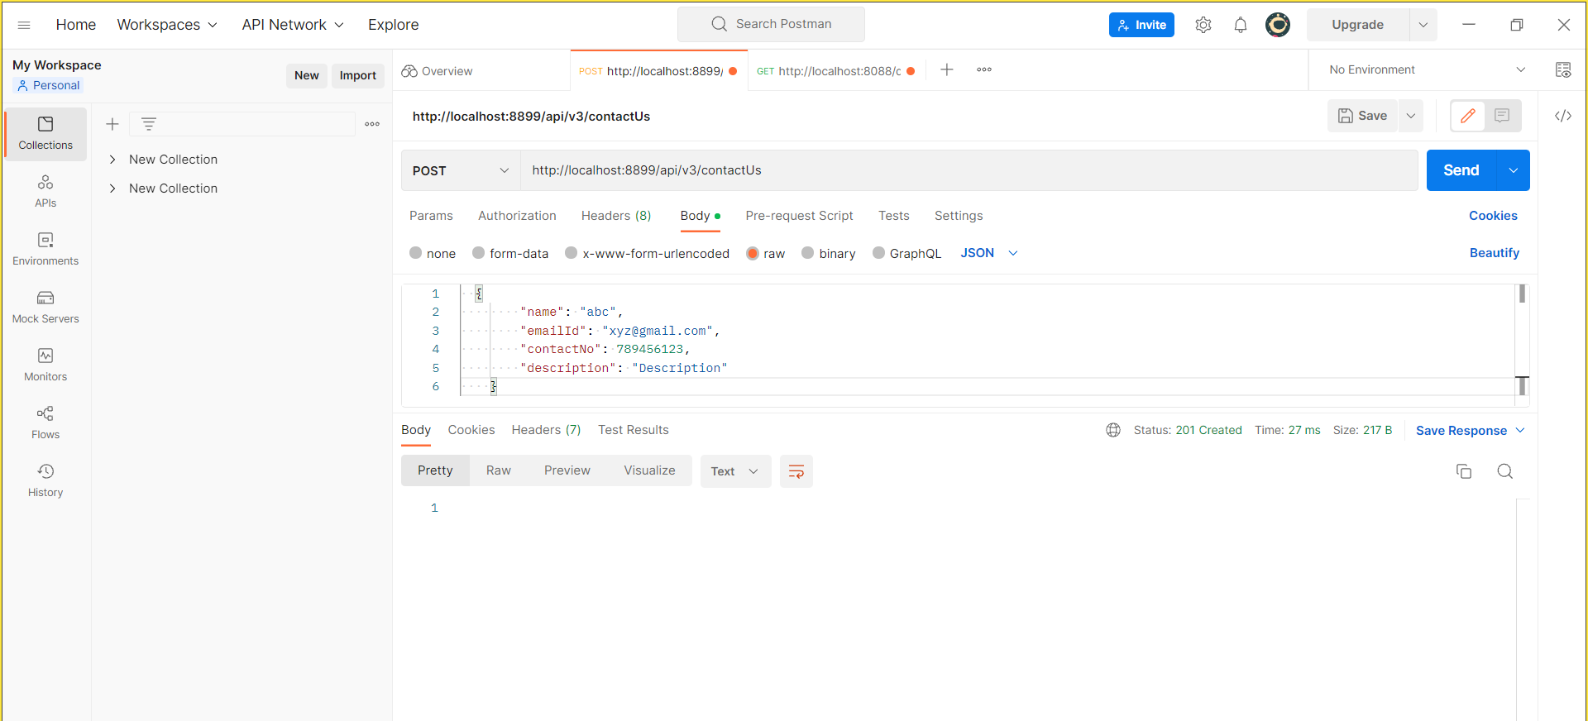

Slide 56
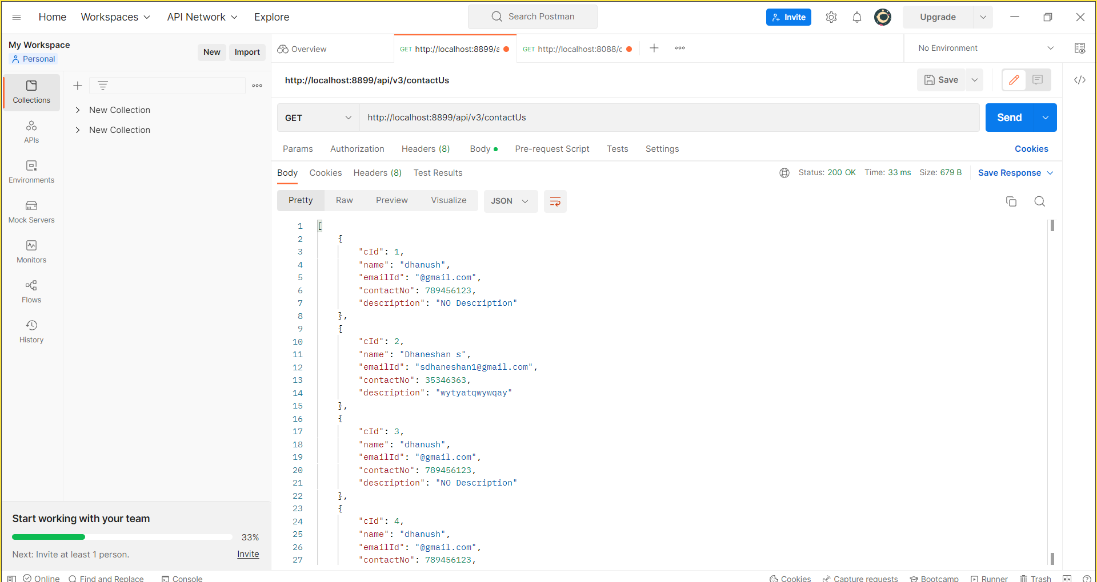

Slide 57
Demo:

Slide 58
ADVANTAGES
User can crosscheck if they have ordered the right medicines with their doctor who is so far .
It can identify the right medicine mentioned by the user.
Users will find it convenient because the system gives precise pricing and product descriptions.
The user can explore many product categories from various pharmaceutical companies in this website.
24✖7 customer care support .
Products will be delivered within 2 days , all over India.
User can claim refund, In Case of late delivery/ damaged products.

Slide 59
ADVANTAGES
It is Cheaper to buy medicines from E-medicare rather than other pharmacies.
People from rural areas can also access quality medicine through this practice.
User can order medicines within few minutes without stepping out from anywhere.
User can change their delivery address.
User can cancel the order whenever they want and the refund will be provided within 3 working days.

Slide 60
CONCLUSION
E-Pharmacy ensures privacy and confidentiality. This system provides great convenience especially for those who are afraid of talking face to face with doctors and pharmacists especially on special issues such as sexuality or adolescence that may be a source of embarrassment.
E-Pharmacy application is time saving You can order your medication within minutes and get your prescription medicines very quickly..
We understand the problem domain and produce a model of the system, which describes operations that can be performed on the system.
We included features and operations in detail, including screen layouts.
We designed user interface and finally, the system is implemented and tested according to test cases.

Slide 61
FUTURE SCOPE
We could add Beauty cosmetic.
We can add Lab Test Option.
We can add things Category wise like –: Ayurvedic , Homeopathy , Fitness ,Surgicals , Devices etc.
Add Different type of shipping options like -: in 1-day , in 3-day , Regular shipping etc.
Can add the Filter option like -: Brand wise, Price wise , Rating wise , Manufactures .
Doctor meet option and can put there a list of Doctor for Different treatment in different category.
Add the option of COVID-19 and in which we can add options like -: test , covid medicine , devices etc.
We can add Care Plan like -: can give them 3-month or 6-month Membership in which they get Faster Delivery and Extra care , If lab test option added than can give 1 free lab test.

Slide 62
REFERENCES
W3Schools :- https://www.w3schools.com/
Bootstrap:- https://getbootstrap.com/
MedicineShopping:http://dspace.daffodilvarsity.edu.bd:8080/handle/123 456789/5013
GeeksForGeeks :- https://www.geeksforgeeks.org/
YouTube :- https://www.youtube.com/
Medplus Mart :-https://www.medplusmart.com/

Slide 63
Thank You !!!

